Slide 1
Access Point and Station
Session: 3

Slide 2
What is an Access Point and Station ?
When you set the ESP8266 as an access point you create its own Wi‑Fi network and nearby Wi-Fi devices (stations) can connect to it (like your smartphone or your computer).
When the NodeMCU is in Station mode, it can connect itself to any Hotspot or Wi-Fi network router.

Slide 3
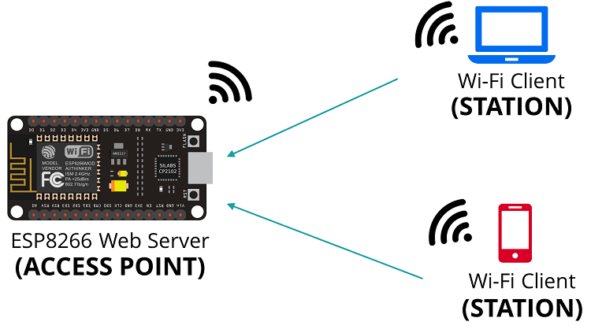
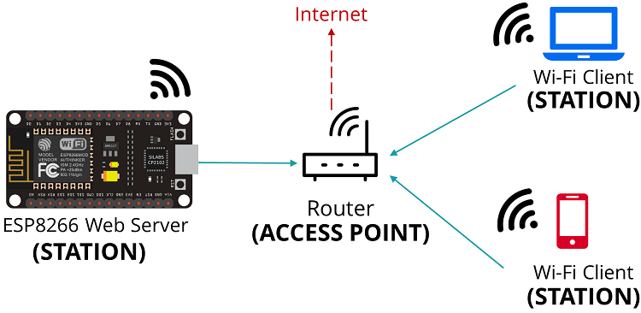

Slide 4
Some Important Commands:
Library: A library is a reusable chunk of code that you may want to include in your programs. These may include message templates, pre-written code and subroutines, values or type specifications.
1. #include <ESP8266WiFi.h> No wifi related commands will work without this library.
2. WiFi.begin("WiFiName", "WiFiPassword"); //Command to connect to a WiFi Network
3. WiFi.status(); //To check if it is connected to a Network or not. WiFi.status() values can be: WL_CONNECTED - connected WL_IDLE_STATUS - trying to connect WL_CONNECT_FAILED - connection failed
4. WiFi.localIP: returns the IP address of the connected network.

Slide 5
5. WiFi.scanNetworks(): Scans for available WiFi networks and returns the discovered number.
6. WiFi.softAP(“network name”, “network password”): Creates its own network and generates its own IP Address.
7. WiFi.softAPIP(): Returns the IP address generated by the nodeMCU behaving as an access point.
8. WiFiClient: Creates a client that can connect to to a specified internet IP address. 9. server.available(): Gets a client that is connected to the server and has data available for reading.

Slide 6
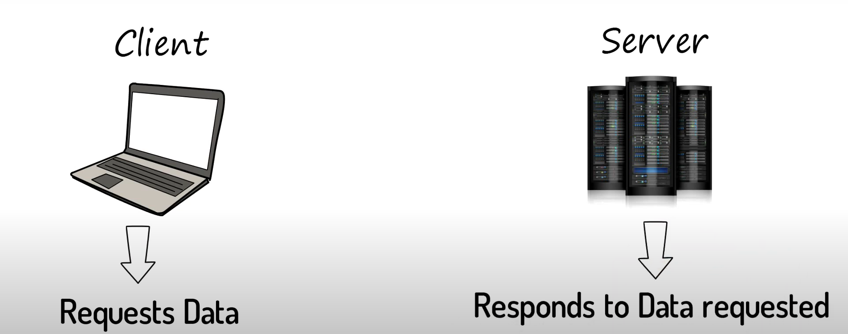
Client and Server:

Slide 7

Example:

Slide 8
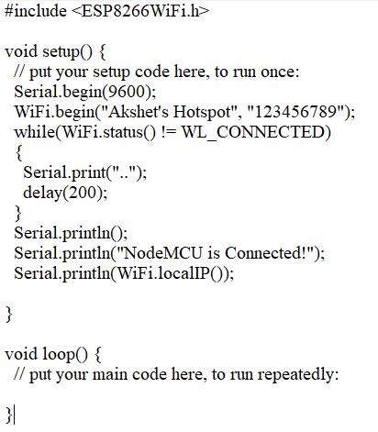
NodeMCU as Station Code:

Slide 9
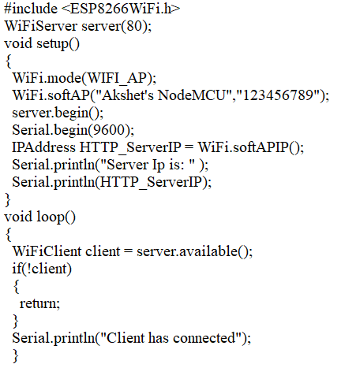
NodeMCU as Access Point Code:

Slide 10
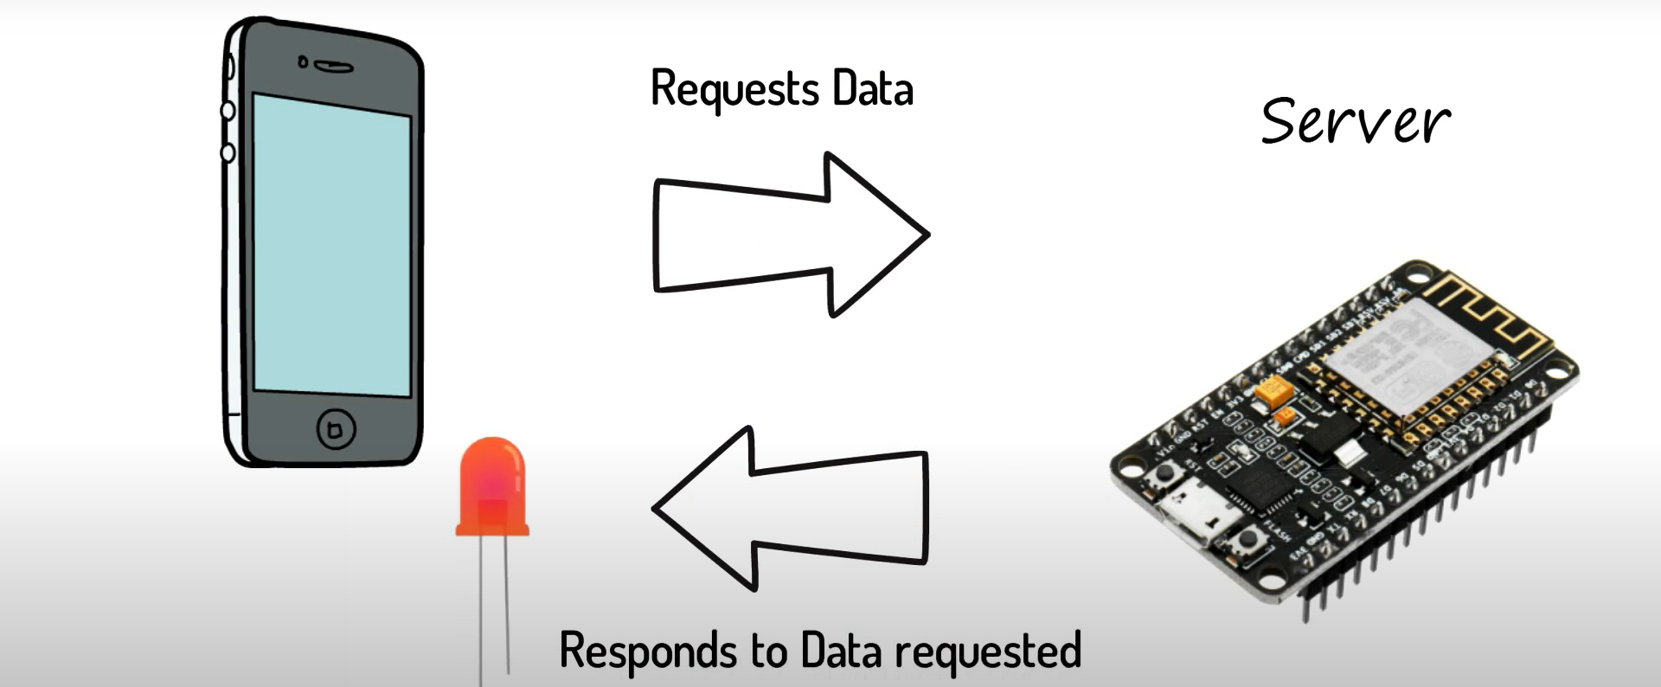
NodeMCU as Server: Coming up in the next session! HTML?

